Slide 1

Professional Practices (HUM-305)
SPRING SEMESTER 2026
By
Prof Engr Muhammad Raheel Iqbal Butt
Resource Person
Contact: +92 321 7433568
School of Computer & Information Technology
Beaconhouse National University, Lahore

Slide 2
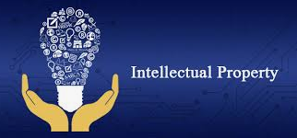

Slide 3
Chap 4: Intellectual Property
Principles, Laws, and Cases
What Is Intellectual Property?
Challenges of New Technologies
A Bit of History
Ethical Arguments About Copying
Significant Legal Cases
Search Engines and Online Libraries
Free Software
What Is Free Software?
Should All Software Be Free?
Search Engines and Online Libraries
Free Software
What Is Free Software?
Should All Software Be Free?

Slide 4
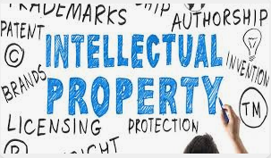
Video
https://study.com/academy/lesson/video/what-is-intellectual-property-definition-laws-quiz.html

Slide 5
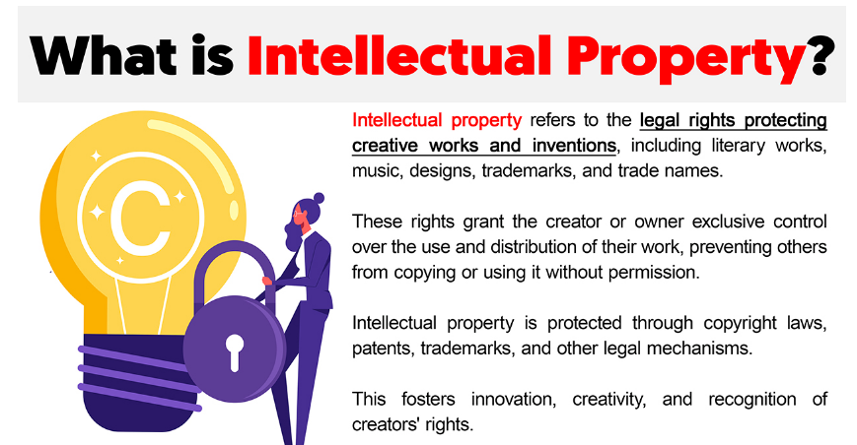

Slide 6
Core Principles of Intellectual Property (IP)
Core Principles of Intellectual Property (IP)
Intellectual Property laws are designed to:
Encourage innovation and creativity
Reward creators financially
Protect ownership rights
Balance public access and private rights
IP mainly includes:
Copyright – protects books, software, music, videos
Patents – protects inventions and processes
Trademarks – protects brand names and logos
Trade Secrets – protects confidential business information

Slide 7
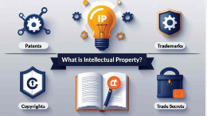

Slide 8
What Is Intellectual Property?
Intellectual Property (IP) refers to creations of the mind such as:
Software code
Research papers
Digital art
Music
Designs
Algorithms
In Computer Science, IP covers:
Source code , Apps, Database, Websites, AI models
Example:
The Windows operating system is protected by copyright owned by Microsoft.
The iPhone design and technology are protected by patents owned by Apple Inc..

Slide 9
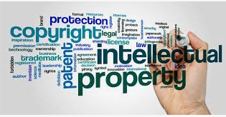

Slide 10
Challenges of New Technologies
Challenges of New Technologies
Technology creates new IP problems:
Digital Copying
Easy to copy software, movies, books.
One click = unlimited duplication.
Internet Distribution
Peer-to-peer sharing (e.g., torrenting).
Cloud storage sharing.
AI & Content Creation
Who owns AI-generated content?
Is training AI on copyrighted data legal?
3D Printing
Physical products can be copied digitally.
Example: Music-sharing platforms like Napster created major copyright conflicts.

Slide 11
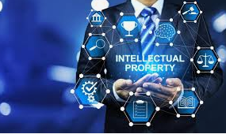

Slide 12
A Bit of History
Early Copyright Law
First copyright law: Statute of Anne (1710) in England.
US Copyright Act: 1790.
Software Protection
In the 1970s, software was not clearly protected.
Later recognized as copyright-protected.
Digital Millennium Copyright Act (DMCA) – 1998
Protects digital content.
Criminalizes bypassing DRM (Digital Rights Management)

Slide 13
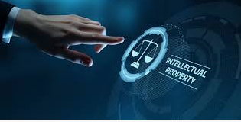

Slide 14
Ethical Arguments About Copying
Arguments Against Copying (Piracy is Wrong)
Creators deserve payment.
Copying harms innovation.
It is theft of intellectual labor.
Arguments Supporting Copying
Information should be free.
High prices limit education.
Sharing promotes knowledge.
Ethical debate: Is downloading a movie illegally the same as stealing a physical object?

Slide 15
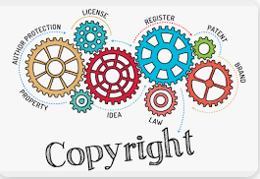

Slide 16
Significant Legal Cases
A&M Records v. Napster (2001)
Napster was sued for enabling music piracy. Court ruled Napster responsible for copyright infringement.
MGM Studios v. Grokster (2005)
MGM Studios sued Grokster. Supreme Court ruled companies encouraging piracy can be liable.
Authors Guild v. Google (2015)
Authors Guild sued Google over Google Books scanning. Court ruled Google's scanning was fair use.

Slide 17
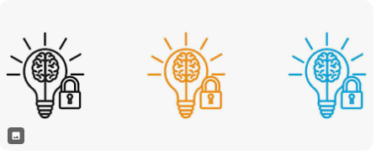

Slide 18
Search Engines and Online Libraries
Search Engines
Search engines like Google:
Copy web pages temporarily.
Store cached versions.
Display snippets.
Legal issue: Is copying web pages for indexing copyright violation? Courts generally allow it under fair use.
Online Libraries
Examples:
Project Gutenberg (public domain books)
Internet Archive
Issues:
Digitizing copyrighted books
Controlled digital lending
Publisher lawsuits

Slide 19
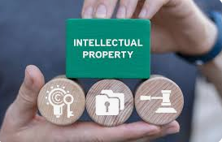

Slide 20
Free Software
What Is Free Software?
Free software means:
Freedom to use
Freedom to modify
Freedom to share
Not necessarily "zero price".
Founded by: Richard Stallman
Organization: Free Software Foundation
Example:
Linux
GNU Compiler Collection
Key Freedoms (Four Freedoms)
Run the program
Study the code
Modify it
Share copies

Slide 21
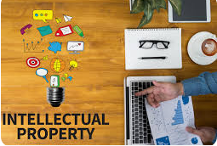

Slide 22
Should All Software Be Free?
Arguments FOR Free Software
Promotes innovation
Reduces monopoly
Improves security (code is open)
Encourages collaboration
Example: Linux powers:
Servers
Android phones
Supercomputers
Arguments AGAINST All Software Being Free
Developers need financial incentive.
Companies invest billions in R&D.
Some projects require strong commercial protection.
Example: Microsoft sells Windows as proprietary software for revenue.

Slide 23


Slide 24
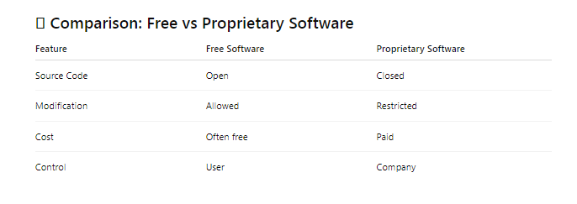

Slide 25


Slide 26


